Slide 1
Instructor Assignment Problem
Presented by:
Ahmmad Saeed 100045067
Begad 100045069
Omran 100045079

Slide 2



Project Description
Main Objective:
Make Professors Happy!
Constraints:
Each course has to be assigned to one professor
Each professor can only teach for a certain number of credits each semester
Lecturers cannot teach higher level courses

Slide 3
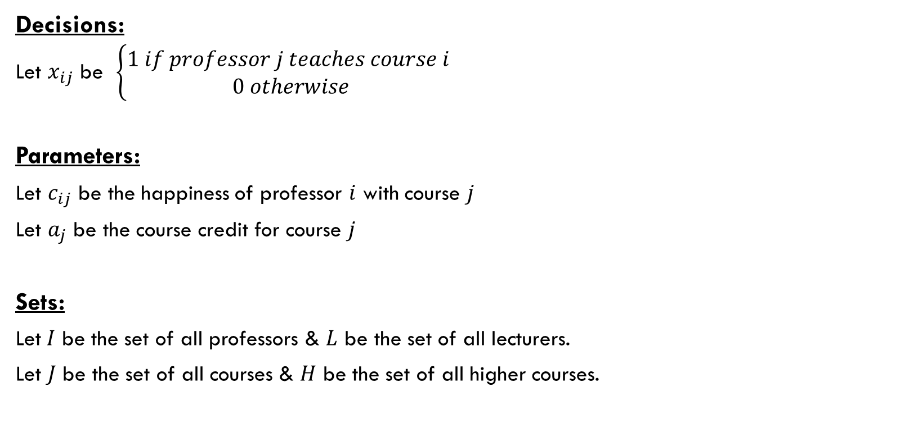
Formulation
Decisions:
Let $x_{ij}$ be $\left\{\begin{aligned}1 if professor j teaches course i \\ 0 otherwise\end{aligned}\right.$
Parameters:
Let $c_{ij}$ be the happiness of professor $i$ with course $j$
Let $a_{j}$ be the course credit for course $j$
Sets:
Let$I$ be the set of all professors & $L$ be the set of all lecturers.
Let $J$ be the set of all courses & $H$ be the set of all higher courses.

Slide 4

Formulation continued…
$$Max z= \sum_{j}^{n}{\sum_{i}^{m}{c_{ij}x_{ij}}}$$
s.t.
$$\sum_{i}^{m}{x_{ij}=1} ∀j∈J$$
$$\sum_{j}^{n}{{a_{j}x}_{ij}≤7 ∀i}∈I$$
$$\sum_{j}^{n}{{a_{j}x}_{ij}≥3 ∀i}∈I$$
$$x_{ij}=0 ∀i∈L, ∀j∈H$$

Slide 5
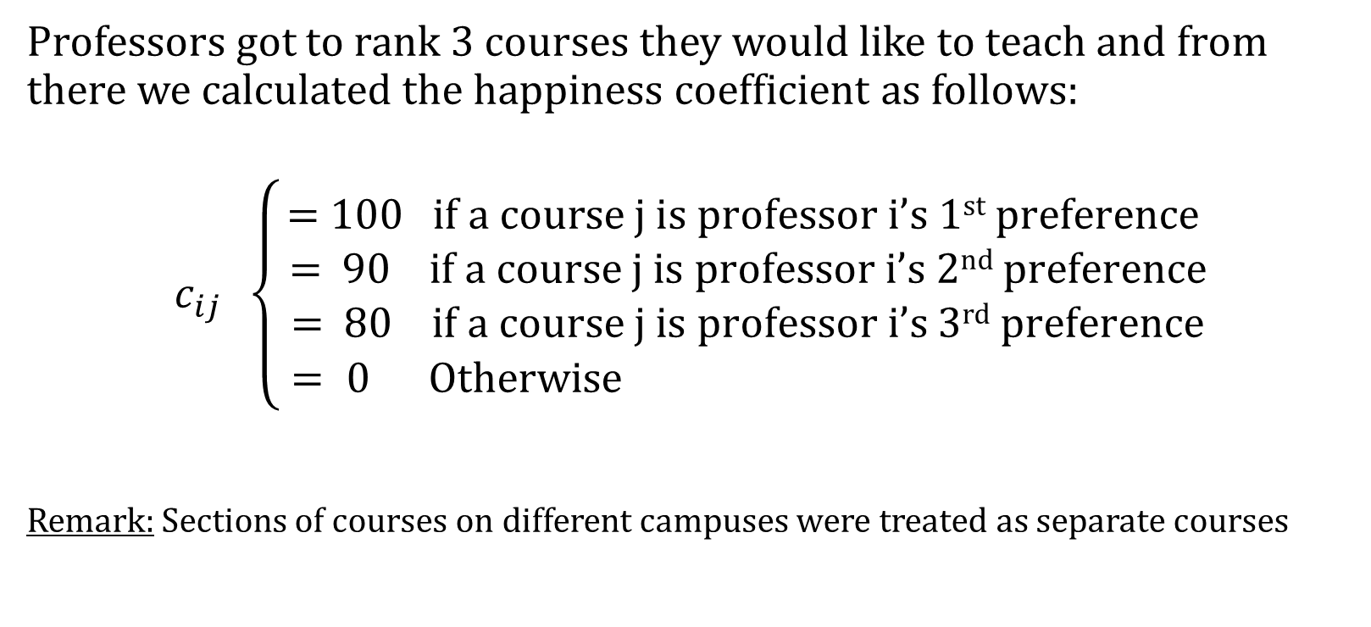

Happiness Coefficient $c_{ij}$
Professors got to rank 3 courses they would like to teach and from there we calculated the happiness coefficient as follows:
$$c_{ij} \left\{\begin{aligned}\text{= 100} \text{if} \text{a} \text{course} j \text{is} \text{professor} i\text{’}\text{s}\text{ 1}\text{st} \text{preference} \\ \text{= } \text{90 } \text{if} \text{a} \text{course} j \text{is} \text{professor} i\text{’}\text{s}\text{ 2}\text{nd} \text{preference} \\ \text{=} \text{ 80 } \text{if} \text{a} \text{course} j \text{is} \text{professor} i\text{’}\text{s}\text{ 3}\text{rd} \text{preference} \\ = 0 Otherwise \end{aligned}\right.$$
Remark: Sections of courses on different campuses were treated as separate courses

Slide 6
DATA PROVIDED

Slide 7
Cleaning up our data

Slide 8
Branch & bound algorithm
1. Branching:
Original problem is partitioned into smaller sub problems.
2. Bounding:
Compute the estimated optimal solution (lower bound) of the considered problem.
Then compare to the best known solution.

Slide 9
Branch & bound algorithm
3. Elimination:
Identify nodes which do not lead to the best solution and eliminate them.
4. Selection:
An exploration strategy where we discover our optimal solution with the best bounds.

Slide 10
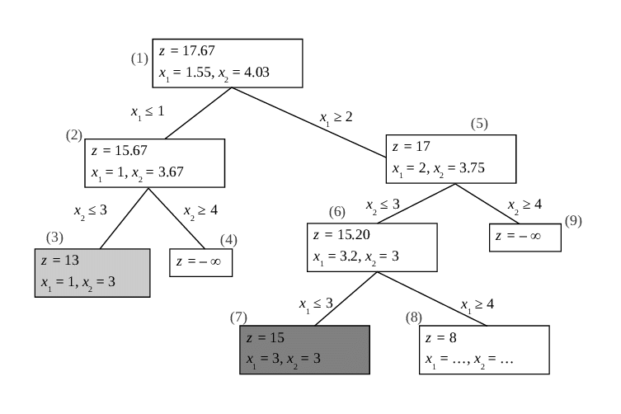
Branch & bound algorithm, example:

Slide 11
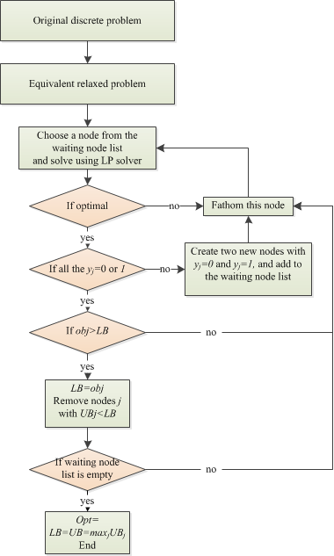

Slide 12
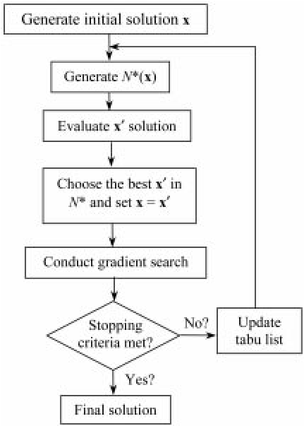
Tabu Search
From https://www.researchgate.net/figure/Flowchart-for-the-Tabu-Search-gradient-algorithm_fig3_228875898

Slide 13
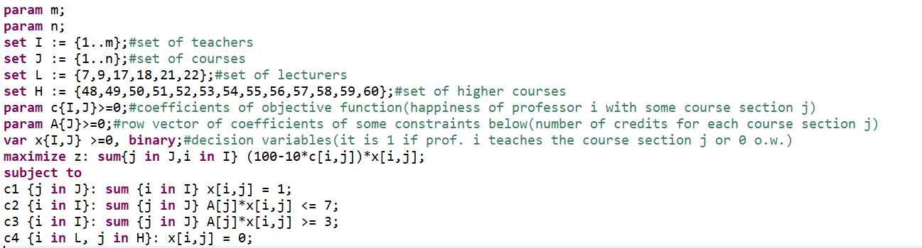
Implementation of solution

Slide 14
Solution
Gurobi solution:
AMPL solution:

Slide 15

Any Questions?

